Slide 1
Skywave:
An Exploration of the Enchanting Impacts of Cosmic Cybernetics
Sarah Hontoy-Major, Jennifer Brown**
**Physically absent, MENTALLY PRESENT SO BAD MENTALLY U CANT GET RID OF ME OK??
I AM A LOOMING SPIRITUAL PRESENCE EXORCISM NEEDED

Slide 2
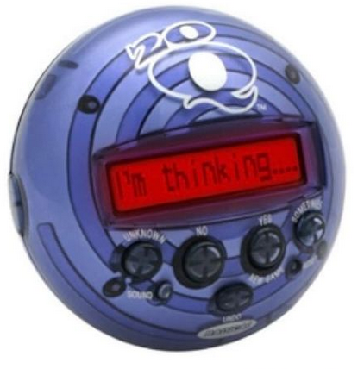
MISSION STATEMENT
SEEK
DESTROY

Slide 3
An Exploration of the Enchanting Impacts of Cosmic Cybernetics
Skywave:
Accurate results not a priority / speculative
We’re looking for magic / Enhanced through tech (David Rose 2014)
In relation to the Universe’s order, nature, patterns, …
Communication between systems (humans and radio)

Slide 4
Keywords
Cosmic Cybernetics
Technopaganism
Radio Skywave Effect
Ritual based in the power
of kinship (sisterhood) in witchcraft*
Natural phenomenon/Enchanted
spell humanity learned to wield
* The definition encompasses much more, generally any use of technology within spiritual contexts

Slide 5
Research Questions
I.
II.
III.
How can enchantment be created or amplified by inferring
natural (analog) modes of communication?
How can both mechanical and human processes be informed by communicating across common channels?
What can be
inferred from cosmic phenomena by exploring their impact upon human and mechanical systems?

Slide 6
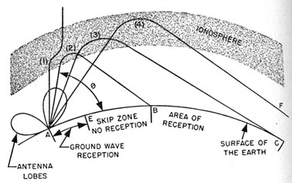
Methodology: Skywave, Radio
An electromagnetic (radio) wave transmitted from an antennae on earth, received elsewhere on earth after being bounced off the ionosphere.
Reduction of ions (created from sunlight) makes ionosphere thinner at night, sending signal farther.
Electromagnetic fields are all around us, produced naturally, of cosmic origins.
Our project explores this phenomena in an enchanted setting, inspired by witchcraft and technopaganism.
Large (and generous) community on air and online (NA, Quebec, Montreal, Concordia!)
https://maritime.org/doc/radio/chap21.php

Slide 7
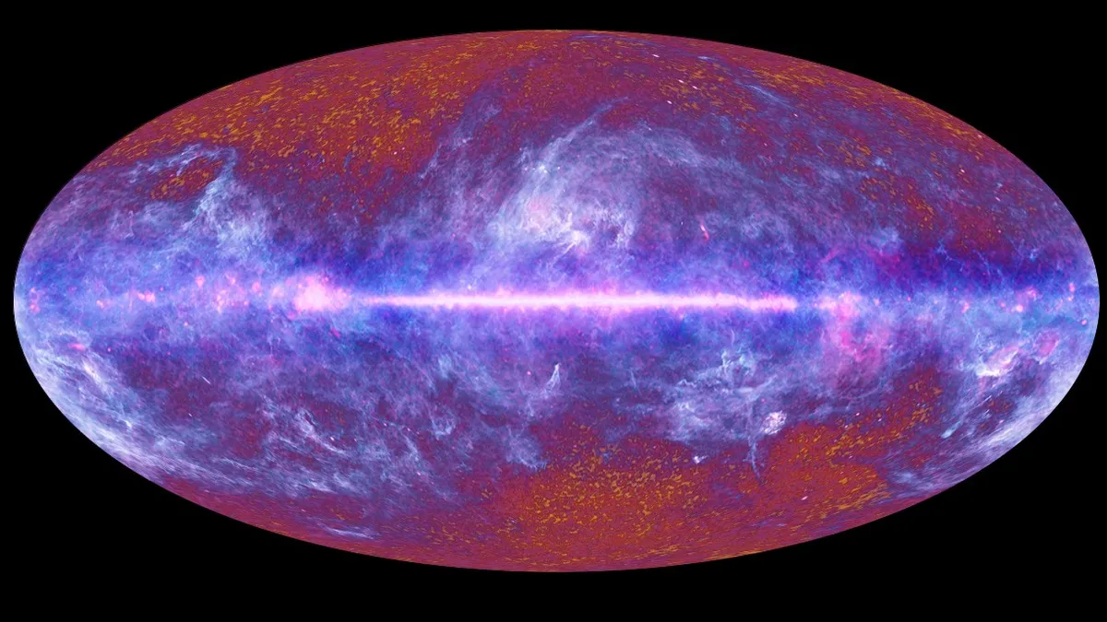
Methodology: Micro/macro scales
Assisted by technology, electromagnetic waves allow us to interact on micro/macro scales.
We can infer several kinds of data depending on the transmitting/processing protocols.
Using Cosmic Microwave Background, we can infer information about the history of the Universe.
… And what else?
This all-sky image of the cosmic microwave background, created from data collected by the European Space Agency's Planck satellite’s first all-sky survey, shows echoes of the Big Bang left over from the dawn of the universe. (Image credit: ESA/ LFI & HFI Consortia) From space.com article, 2022

Slide 8


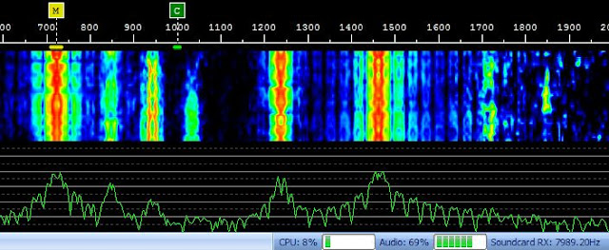
Methodology: Communication Modes
PSK-31 (Phase Shift Keying, 31 baud) is a keyboard-to-keyboard digital mode that allows communication through text via radio signal.
Works under poor conditions and transmits at an average typing speed.
Waterfall Displays: X = frequency domain/span; Y = different data sweep with time; Z = spectrogram (heat map) with a real-time spectrum analyzer (at the bottom, frequency in x, amplitude in y)
Binary PSK-31 sample on SigidWiki
Waterfall display of digital mode from hamprojects.blogpost.com (2013)

Slide 9
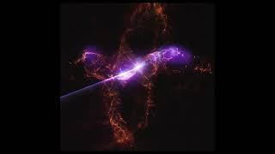
Inspirations
Cosmic Harmonies
By Jonathan Deal, Megan Watzke, 2023. NASA.
Sonification: The process of converting data from visual to audio. The sound is associated with various spectra of light captured by telescopes.
View Here.

Slide 10
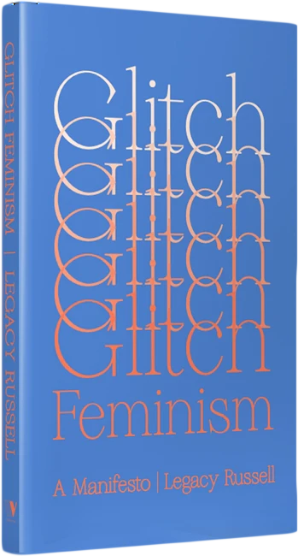
Inspirations
Glitch Feminism
Manifesto and site by Legacy Russell.
Glitch Feminism is a response to Cyberfeminism, encouraging a deeper disruption of oppressive systems, harnessing the metaphor of the glitch.
View Here.

Slide 11

Inspirations
Chronogenica
Co-operative and video by Zeph Thibodeau (& members)
Chronogenica is a co-operative that empowers and advocates for machines and their human colleagues.
View Here.

Slide 12
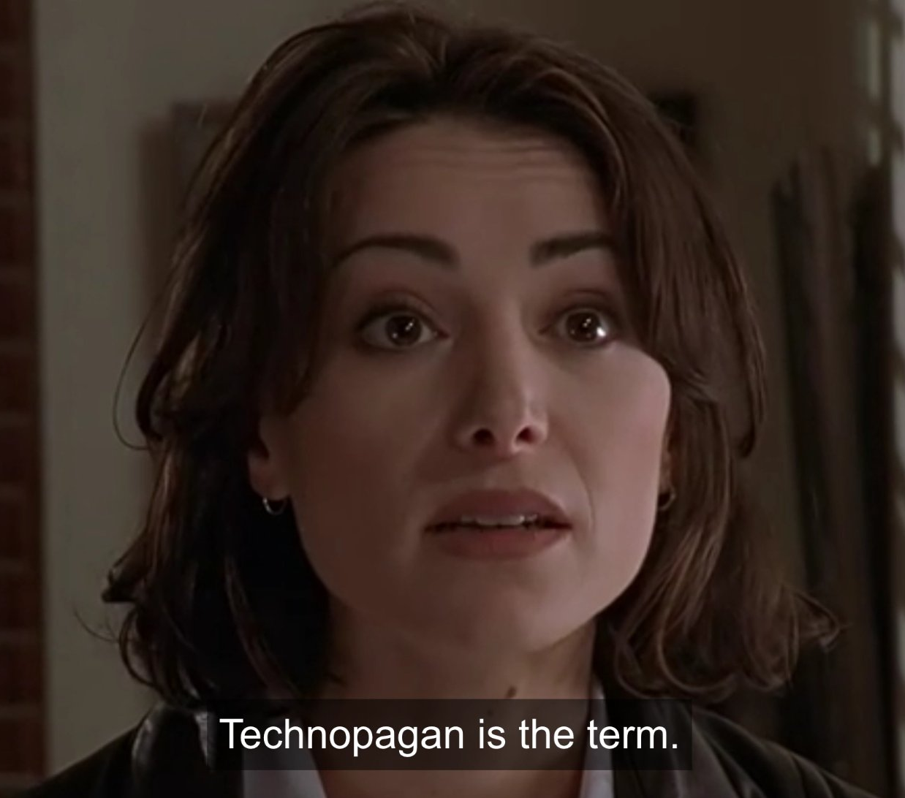
Methodology: Data Input, Ritual
Train ML model on open-source data + own data to explore variating outputs we can get from it
We will host a ritual comprised of human and radio participants communicating with and between each other.
We will input communication data (electromagnetic frequencies + speculative somatic data*) into wekinator and translate (mapping through regression) to a common frequency, making humans and machines converse in the same language.
This frequency will be processed by TouchDesigner to provide a 3D environment in which to explore this mapped output, inspired by waterfall displays.
Our project will culminate in a video combining footage from the ritual, gathered data, and Touch-Designer based A/V art
Buffy, the Vampire Slayer, Kill Switch S05e11
Notes:
(likely returning a frequency modified by sensor data)

Slide 13
Partial References
Zotero
Davis, Erik. 2015. TechGnosis: Myth, Magic, & Mysticism in the Age of Information. Berkeley, [California]: North Atlantic books.
Schröder, Frank Gerhard. 2012. Instruments and Methods for the Radio Detection of High Energy Cosmic Rays. Springer Theses. Berlin Heidelberg: Springer.
The physics of the ionosphere, from the perspective of a ham radio user. Poole (G3YWX), Ian. 1999. Radio Waves and the Ionosphere. The National Association for Amateur Radio (ARRL). Staines, United Kingdom. https://www.arrl.org/files/file/Technology/pdf/119962.pdf
Edward Lewis, Jason, Noelani Arista, Archer Pechawis, and Suzanne Kite. Making Kin with the Machines chapter in Atlas of Anomalous AI.UK: Ignota Books. P.40-52

Slide 14
Timeline
March 28
April 4
April 11
Proposal, Feedback
Reach out to Concordia Radio Club
Interview primary references
Documentation, Research
Equipment Experimentation
Prototype our ML model and inter-machine communication
Refine model and output
Plan ritual, meet with participants
Gather training data
Draft documentation
April 18
April 25
April 26
Conduct ritual
Post-ritual data processing
TouchDesigner
Video editing
Presentation Day
Documentation complete
Final Report Submission

Slide 15
“Skywave explores the invisible impacts of cosmic interaction upon both machines and humans. Culminating as a ritual between human and non-human participants, radio transmission and machine learning are utilized to explore systems of communication between humans, machines, and the natural world. In joining witchcraft and modern technological frameworks, we explore new paradigms where natural and animistic concepts intertwine with information technology, informing new modes of communication.”

Slide 16
Thank you

